Slide 1
Wireless Carbon Nanofiber Aggregate Sensor System for Real-Time Water Level Monitoring and Flood Warning
Y.L. Mo, Yuhua Chen , Jinghong Chen – University of Houston
T.G. Cleveland Texas Tech University

Slide 2
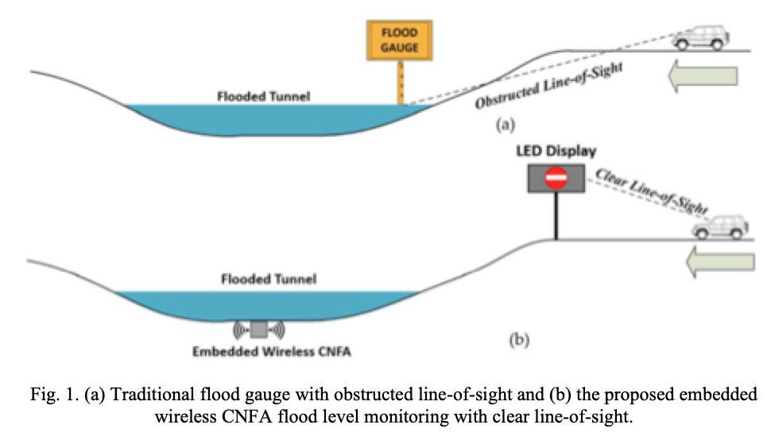
Application Concept
(2) Microprocessor sends signal to warning display
(1) Sensor embedded into material.

Slide 3
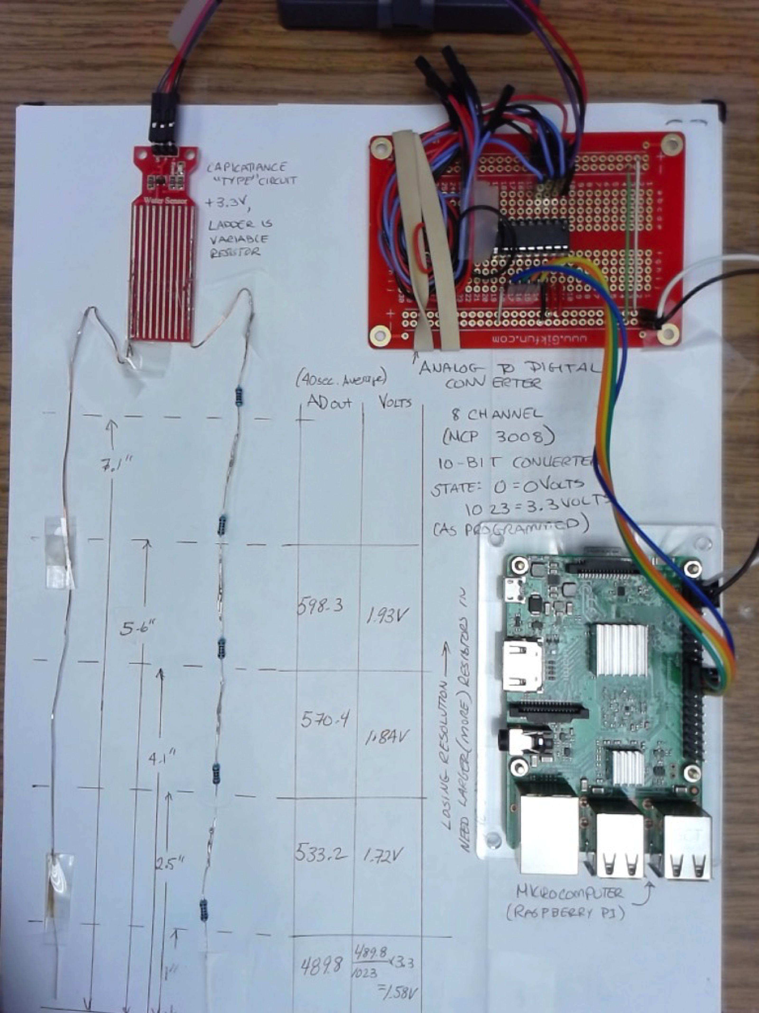
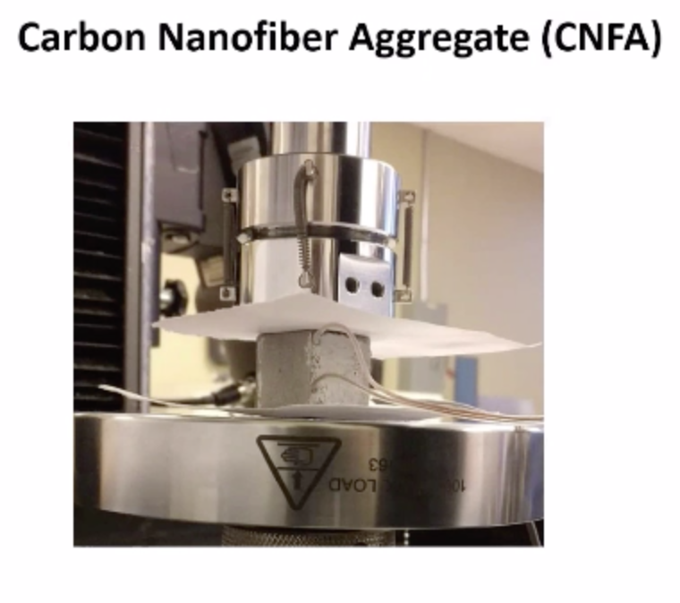
Sensor(s)
Contact Sensor
Depends on water to complete a circuit
Measures water only
Image shows sensor, and microprocessors
Embedded Sensor
Monitors health of structural element, not just water depth
Depends on water to compress material to generate a low magnitude stress signal

Slide 4
Status
Contact Sensor
Proven technology
System integration and fabrication of self-calibrating sensor ladders
Power management is an issue -- as pictured the device uses a lot of power – the microprocessor has to sleep and awake for reasonable run time on battery supply
What is desirable failure mode behavoir (to program into the microprocessor)

Slide 5
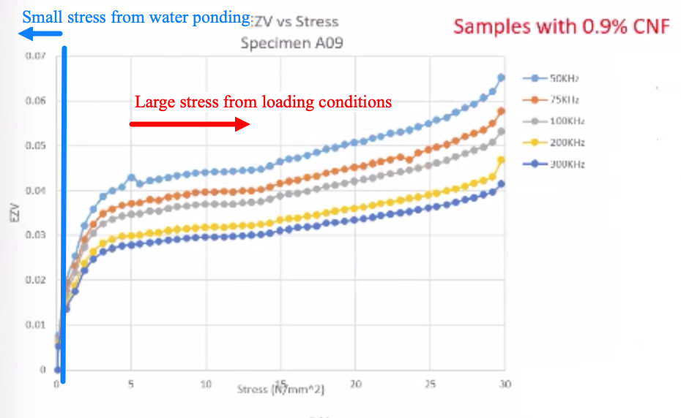
Status
Embedded Sensor
Sensitivity – Needs to perform in the “blue” region for water detection
Sensitivity is frequency related

Slide 6
On-Going Path
Contact sensor considered as a state-of-practice level technology
Embedded sensor to be developed to produce information on par with contact sensor

